Slide 1
Lecture 11: Recurrent Neural Networks
Elad Hoffer
Boris Ginzburg

Slide 2
Agenda
Sequence Classification & Labeling
Introduction to Recurrent NN
Simple RNN
Bidirectional RNN
Vanishing gradient problem
3. Recurrent models
LSTM (Long-Short Term Memory)
GRU (Gated Recurrent Unit)
NTM (Neural Turing Machine)
Links:
Hinton’ course on Deep Learning
Schmidhubber tutorial on LSTM http://people.idsia.ch/~juergen/lstm/
A. Graves, Supervised Sequence Labelling with Recurrent Neural Networks,

Slide 3
Sequence Modeling

Slide 4
Auto-regression
predict the next term in the input sequence.
The target output sequence is the input sequence with an advance of 1 step
It uses methods designed for supervised learning, but it doesn’t require a separate teaching signal
W
X(t-3)
X(t-2)
X(t-1)
X(t)

Slide 5
Sequence Classification & Labeling
The sequence labeling
Handwriting Recognition
Speech Recognition
Part-of-speech tagging
Language translation
Special case of pattern classification:
individual data points cannot be assumed to be independent.
Both the inputs and the labels form strongly correlated sequences. For example a speech signal is produced by the continuous motion of the vocal tract, while the labels (a sequence of words) are constrained by the laws of syntax and grammar.

Slide 6
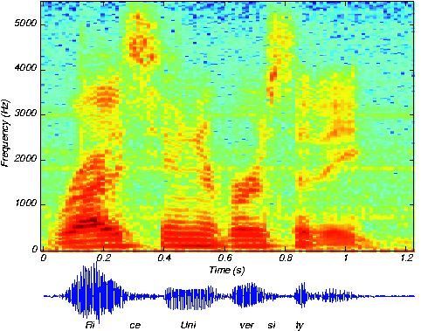
Speech Recognition
X=[x(1),…x(T)] – input vector:
Each x[t] is spectrogram at moment t:
x(t)=[x(t;1),…x(t,N)], x(t,k) is energy in frequency band k.
The goal is to convert X to sequence of symbols:
Y=[y(1),..y(K)], where y(k)={a,.., z, “,” , “.”, blank}
nice university

Slide 7
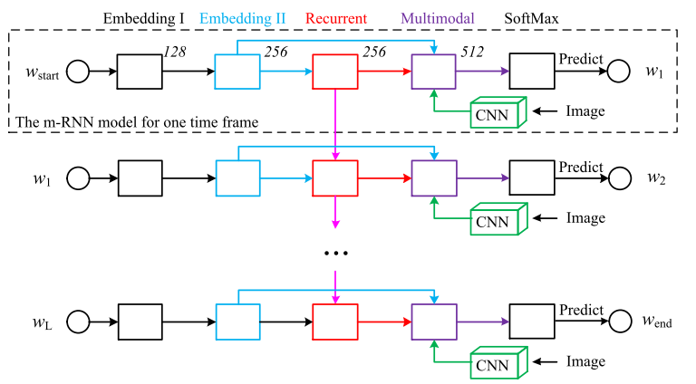
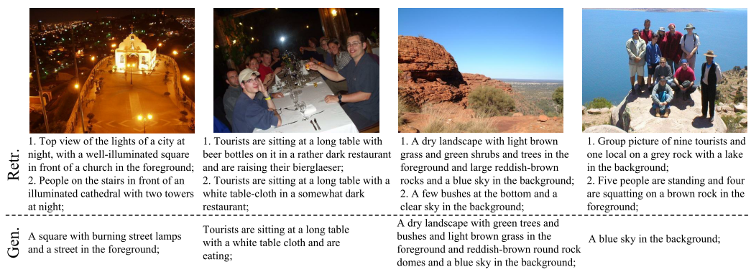
RNN Examples - vision
Deep Captioning with Multimodal Recurrent Neural Networks (Junhua Mao et al 2015)

Slide 8
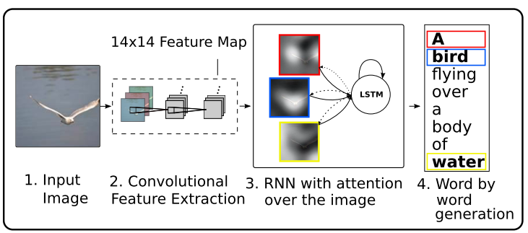
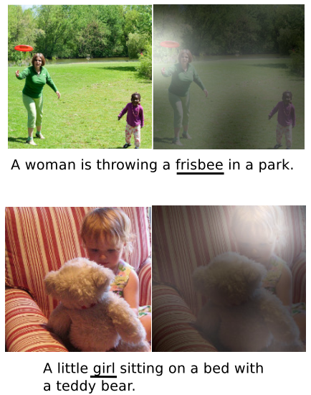
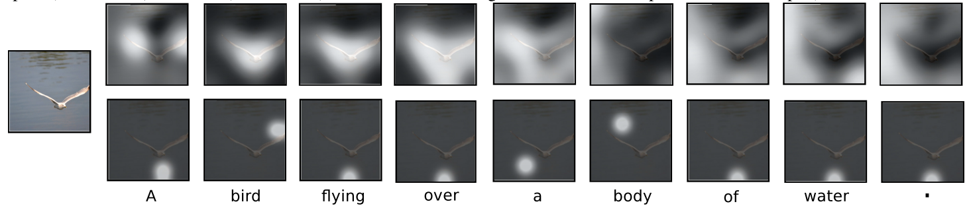
RNN Examples - vision
Show, Attend and Tell: Neural Image Caption Generation with Visual Attention (Kelvin Xu et al, 2015)

Slide 9
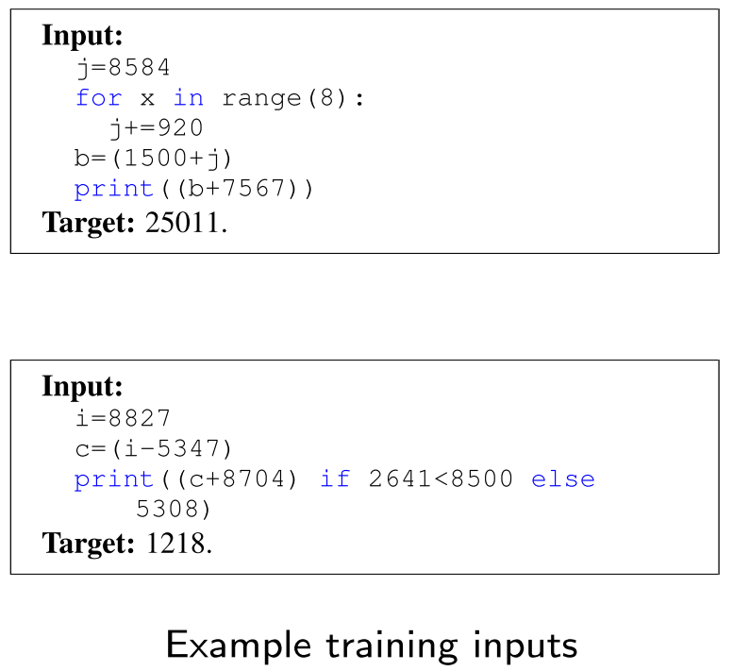
RNN Examples
Learning to execute (Zaremba, Sustkever 2015)

Slide 10
Introduction to Recurrent NN

Slide 11
Approaches to Time Dependent NN
Feedforward architectures (time-delayed neural networks)
Recurrent architectures - represent time recursively
Simple recurrent network (SRN)
Gated Recurrent Architectures (LSTM, GRU)
Explicit memory architectures
Neural Turing machines
Memory networks
Stack RNN

Slide 12
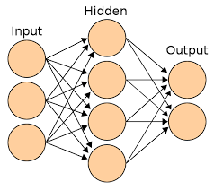
Feed Forward Time-Delay NN
Feed-forward NN (e.g. Conv NN) that represent time explicitly with a fixed-length window of the recent history :
X(t-k)
X(t-2)
X(t-1)
X(t)

Slide 13
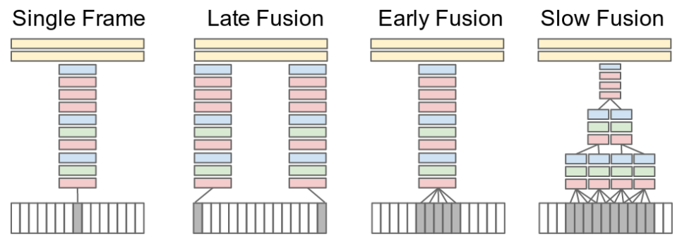
Example - Time-Delay NN
Large-scale Video Classification with Convolutional Neural Networks (Karapthy 2014)
Problems?
Fixing the window size makes long-term dependency harder to learn
Linear increase of the number of parameters

Slide 14
Approaches to Time Dependent NN
Feedforward architectures (time-delayed neural networks)
Recurrent architectures - represent time recursively
Simple recurrent network (SRN)
Gated Recurrent Architectures (LSTM, GRU)
Explicit memory architectures
Neural Turing machines
Memory networks
Stack RNN

Slide 15
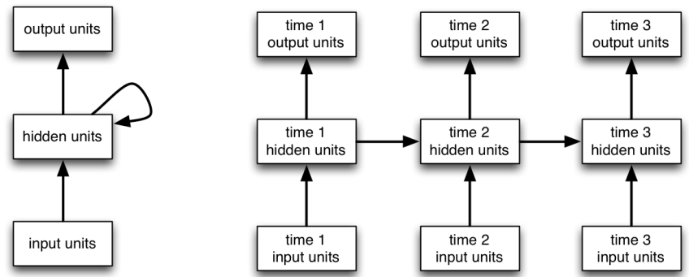
Recurrent NN
Recurrent neural networks (RNNs) is a NNs where connections between units form a directed cycle.

Slide 16
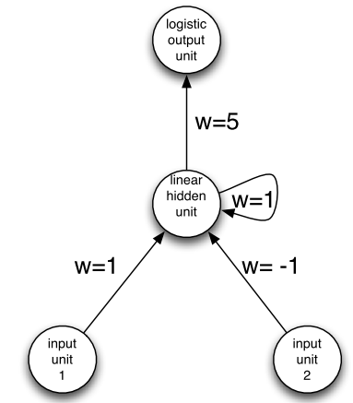
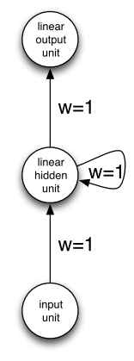
Recurrent NN
RNNs use their hidden states work as memory on previous inputs & states
Temporal dependency & internal memory allow processing of sequences of inputs
Turing complete (Siegelmann &Eduardo)

Slide 17
RNN training
Back propagation through time:
Unfold network in time (remember all interm. steps)
Apply gradient back-propagation recursively back in time from T to 1
Sum over the whole sequence ( t=1..T) to get the derivatives with respect to the weights
Rumelhart, Hinton, Williams Learning internal representation by error propagation, 1996

Slide 18
Bidirectional RNN
For many sequence labelling tasks it is beneficial to have access to future as well as past context.
Most obviously, if the input sequences are spatial and not temporal (protein structure prediction)
temporal tasks, as long as the network outputs are only needed at the end of some input segment (handwriting & speech recognition)
Workaround: fixed n look–ahead window to input.
Bidirectional RNN - more generic idea:
present each training sequence forwards and backwards to two separate recurrent hidden layers, both of which are connected to the same output layer.

Slide 19
RNN: vanishing gradient problem
RNN forward and backward propagation has short memory:
the influence of a given input on the hidden layer, and therefore on the network output, either decays or blows up exponentially
The same with gradient propagation

Slide 20
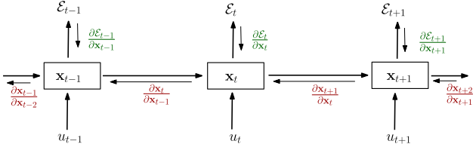
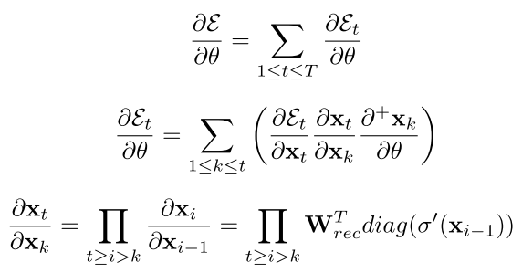
RNN: vanishing gradient problem
Pascanu et Al, On the diﬃculty of training recurrent neural networks

Slide 21
Approaches to Time Dependent NN
Feedforward architectures (time-delayed neural networks)
Recurrent architectures - represent time recursively
Simple recurrent network (SRN)
Gated Recurrent Architectures (LSTM, GRU)
Explicit memory architectures
Neural Turing machines
Memory networks
Stack RNN

Slide 22
Long Short-Term Memory Networks

Slide 23
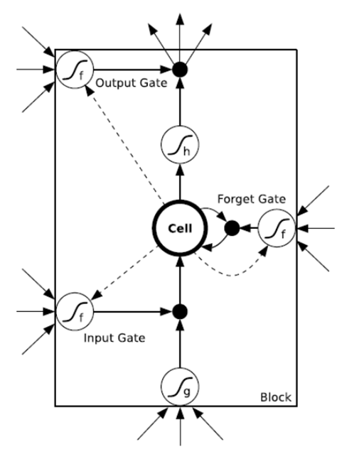
Long Short-Term Memory (LSTM)
Long Short-Term Memory (LSTM) architecture was proposed by Hochreiter and Schmidhuber,1997.
A new basic element memory cells
The input and output gates multiply the input and output of the cell
f is logistic sigmoid: 0 = gate closed, 1 = gate open
Forget gate multiplies the cell's previous state
works as “reset”

Slide 24
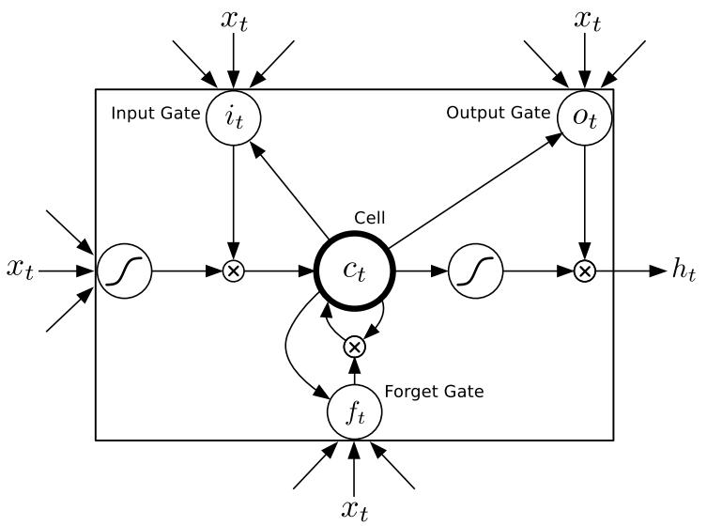
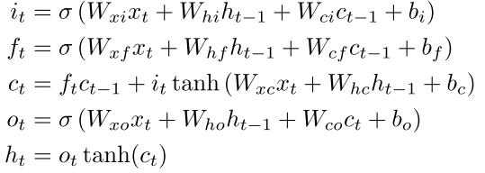
LSTM
Alex Graves, Generating Sequences With Recurrent Neural Networks

Slide 25
LSTM network
LSTN Net composed from “memory cells”
Training with gradient back-propagation through time:
usually gradient is truncated after 1-2 steps

Slide 26
LSTM and vanishing gradient
LSTM has LONG memory.
For simplicity, all gates are either entirely open (`O') or closed (`|').
The memory cell `remembers' the first input as long as the forget gate is open and the input gate is closed.

Slide 27
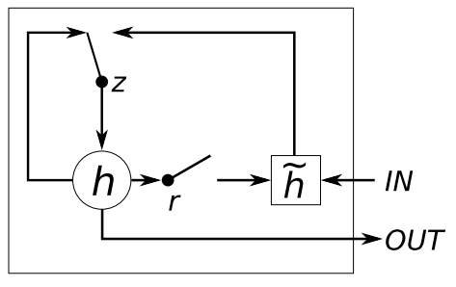




GRU – Gated Recurrent Unit

Slide 28
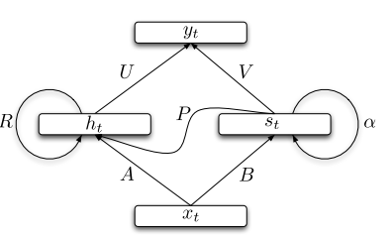

SCRNN – Structurally constrained RNN
Mikolov et al, Learning Longer Memory in Recurrent Neural Networks

Slide 29
Approaches to Time Dependent NN
Feedforward architectures - represent time explicitly with a fixed-length window of the recent history (time-delayed neural networks)
Recurrent architectures - represent time recursively
Simple recurrent network (SRN)
Gated Recurrent Architectures (LSTM, GRU)
Explicit memory architectures
Neural Turing machines
Memory networks
Stack RNN

Slide 30
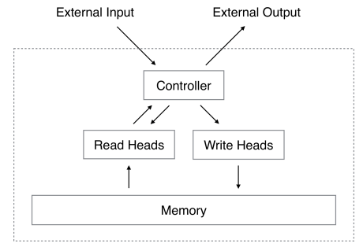


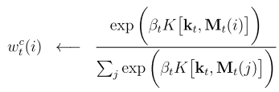
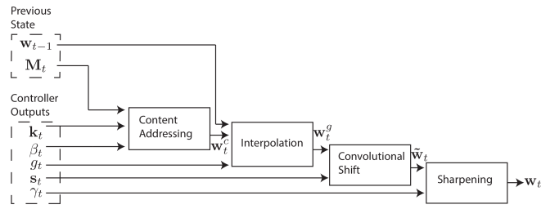
NTM – Neural Turing Machine
Differentiable memory operations
Read:
Erase:
Write:
Focus:

Slide 31
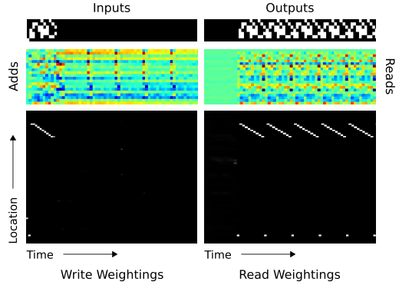
Neural Turing Machine
Repeat copy task
Graves et al, Neural Turing Machine

Slide 32
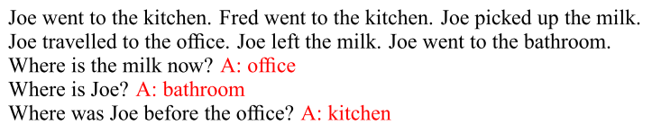
And more…
Memory network (Weston et al 2015) – having explicit memory, answering questions on gathered knowledge.
Stack-Augmented Recurrent Nets (Joulin, Mikolov 2015) - count and to memorize sequences.

Slide 33
Having fun with LSTM
Train character-level language models based on multi-layer LSTMs
Some fun examples at http://karpathy.github.io/2015/05/21/rnn-effectiveness/
Can we generate Bible chapters that seem reasonable?

Slide 34
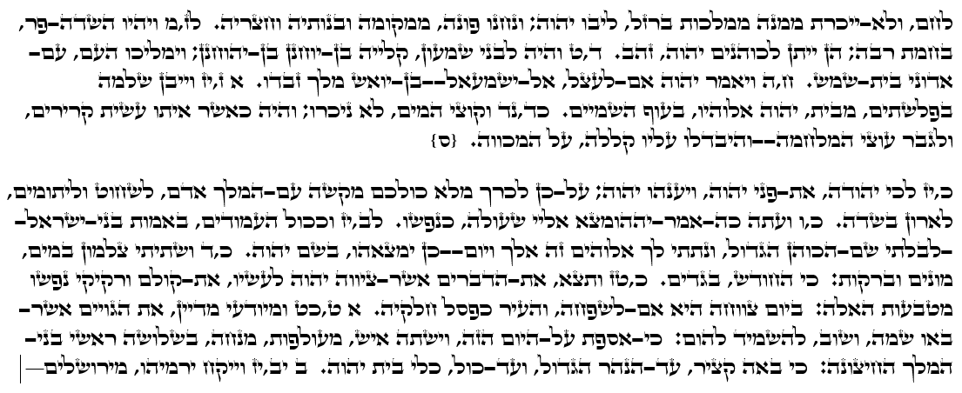
Having fun with LSTM
Biblical LSTM

